Slide 1
Microservices and RESTful API
Classroom

Slide 2
Microservice Transactions
Challenges to many microservices
Coordinate operations
Handle Failures and Exceptions
Integrate business logic
Coordination or Orchestration
To monitor and co-ordinate operations of each microservice collect and hold state information centrally in a datastore e.g. DynamoDB
Use an orchestration tool to coordinate the microservice integration
AWS Step Functions
A State Machine that will provide a workflow to orchestrate your business logic
Notes:
Moving from a more monolithic architecture to a microservice architecture brings additional challenges.
If a user performed a search on a series of products and picked one or more to go into the shopping cart and then checked out a series of operations would need to take place. Each one of these would be distributed across different microservices.
Payment would need to be selected – a lookup for credit card information or PayPal information etc
Either a direct call or through a gateway would need to be attempted for payment to be made (values retrieved/passed from cart service)
If payment successful (this is high level, not in chronological order)
Cart emptied
Order recorded
Stock level decremented
Customer notified
Notification sent to fulfilment
etc
If payment is not successful then error returned to customer to retry or cancel order.
As can be seen a number of microservices must be passed data and their corresponding datastores updated or services perform operations. This has to be dealt with as one transaction – All or nothing.
There is choice. Do we build transactional handling into the microservice code or do we centrally manage this by an orchestration microservice or pre-existing services.
If the former is chosen then each microservices can record its state in a database such as DynamoDB. This can be cross-referenced by other microservices that can make independent, but coordinated decisions on whether their respective operations should persist or roll-back and be discarded should the transaction fail. The code needs to be built into each microservice.
Alternatively another microservice is used as an orchestrator to trigger operations between microservices and pass data. Of course the orchestrator could monitor and mange the operations of the other microservices and the data they store in such services as DynamoDB. The main point here is that there is a central decision maker to control the workflow. Additionally, as this orchestrator provides such an important role fault tolerance and scalability is critical to the reliability of our service.
BIG BUT….. We are ideally using the cloud. Many services to call upon to help us provide this scalability and fault tolerance. Some may be provided to us as a managed services, scalable and fault tolerant in its own right. Step Functions is such an AWS service.

Slide 3
Is a visual-workflow service to orchestrate services
Execute more than one Lambda in parallel
Runs functions in parallel
Retry functions
Restart failed Lambdas
Long running code
Lambda had max timeout 15minutes – Call on external (Aws Services) for long running activities
Coordinate asynchronous functions
Manage try-catch-finally
Sequence functions
Choose function flow based on values
Step Function – What can I do?
Notes:
Using State Machine Language which is basically a JSON document describing the steps you wish transition though and with each step what you would like to do next.
For example from step 2, run this step 3 by executing lambda function A
Step functions act as the orchestrator with each step passing event data to the lambda and retrieving the output (including exceptions being thrown) either to be handled, evaluated or passed onto the next step and function.
The ability to trigger an activity with another AWS Service and await a response before moving to the next step, gives capability to build a workflow with microservices running beyond just lambda and controlling their integration with other datastores and services.
{
"Comment": "An example of the Amazon States Language using a choice state.",
"StartAt": "FirstState",
"States": {
"FirstState": {
"Type": "Task",
"Resource": "arn:aws:lambda:us-east-1:123456789012:function:FUNCTION_NAME",
"Next": "ChoiceState"
},
"ChoiceState": {
"Type" : "Choice",
"Choices": [
{
"Variable": "$.foo",
"NumericEquals": 1,
"Next": "FirstMatchState"
},
{
"Variable": "$.foo",
"NumericEquals": 2,
"Next": "SecondMatchState"
}
],
"Default": "DefaultState"
},
"FirstMatchState": {
"Type" : "Task",
"Resource": "arn:aws:lambda:us-east-1:123456789012:function:OnFirstMatch",
"Next": "NextState"
},
"SecondMatchState": {
"Type" : "Task",
"Resource": "arn:aws:lambda:us-east-1:123456789012:function:OnSecondMatch",
"Next": "NextState"
},
"DefaultState": {
"Type": "Fail",
"Error": "DefaultStateError",
"Cause": "No Matches!"
},
"NextState": {
"Type": "Task",
"Resource": "arn:aws:lambda:us-east-1:123456789012:function:FUNCTION_NAME",
"End": true
}
}
}

Slide 4
AWS Step Functions
Enables you to coordinate the components of distributed applications and microservices using visual workflows.
Manages the underlying infrastructure to ensure your application is available at any scale.
In this lab, you will see what AWS Step Functions are and what types of problems this service is best suited to solve.
Combines Lambda and Step Functions for a gaming application.
Learning Objectives
Understand what AWS Step Functions is and how to use it
Components of Step Functions and how to configure them
Implement Parallel Steps, when to use them and why
Understand when best suited to using Conditional Steps
Make a State Machine log to the CloudWatch service
Create and test a State Machine
Lab

Slide 5
Lab Activity
You'll use Cloud Academy to explore using an orchestrator to control the execution of Microservices
The example given uses Lambda, but Step Functions can integrate with other service activities such as Container Services (ECS) etc
Introduction to AWS Step Functions
Duration: 1hr 30 mins
Notes:
https://app.qa.com/lab/introduction-aws-step-functions/ (approx. 1hr 30min)

Slide 7
Cart Service: Adds item to cart. Initiates checkout ➡️ event for Inventory service
Inventory Service: Reserve item ➡️ Event to Cart Service.
Checkout Service: Initiate checkout ➡️ Event to Payment Service
Payment Service: Process payment ➡️ Event to Order Service.
Order Service: Create order ➡️ Event to Inventory and Shipping Service.
Shipping Service: Schedule dispatch ➡️ Event to Notification Service.
Notification Service: Send user notification

Slide 8
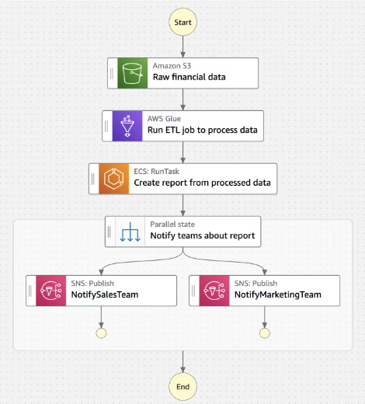

Slide 9
Drag-and-drop visual editor to assemble microservices into unified workflows.
Manage input, output, error handling, and retries.
Developers can focus on business logic rather than writing integration code
Decouples business logic from the code that defines how your application is implemented.
Metrics: Activity, Service matrices
The number of times a state machine started, succeeded, and failed, and the length of time
Parallel processing
Activity task - External may require human approval as well as Service task
Data can be passed from one task to another.
Handles failure or success
Pause time
Repeat execution for each item of input

